Slide 1
Internationalization in Java
Advanced Programming

Slide 2
Internationalisation features of Java
Amongst other things, Java is an Internet programming language.
People who use the Internet may not necessarily speak or use English.
What is useful to a speaker of English may be useless to a speaker of Spanish or Russian.
Many web sites maintain different versions of their web site pages to cater to the different language communities that they service.

Slide 3
Internationalisation features of Java
Java is the first computer language designed to provide direct support for internationalization.
This means that it allows your programs to be customized for any number of languages in any number of countries without requiring cumbersome changes to the code.

Slide 4
Internationalisation features of Java
The following are the major features of Java that support internationalization.
  Java characters use Unicode.
  Java provides the Locale class.
  Java uses the ResourceBundle class for locale specific information

Slide 5
Unicode

Slide 6
Java characters use Unicode
This is a 16-bit encoding scheme established by the Unicode Consortium to support the interchange, processing, and display of written texts in the world’s languages.
Using Unicode encoding makes it easier to write Java programs that manipulate strings in any international language.

Slide 7
Locales

Slide 8
Java provides the Locale class
The Locale class encapsulates information about a specific locale.
A locale determines how locale-sensitive information like date, time, and numbers is displayed and how locale-sensitive operations are performed.
The classes for formatting date, time and numbers and for sorting strings are grouped in the java.text package.

Slide 9
Java Resource Bundles
Java uses the ResourceBundle class for locale specific information such as status messages, exceptions and GUI component labels from the program.
The information is stored outside the source code and can be accessed and loaded dynamically at runtime from a ResourceBundle, rather than hard-coded into the program.

Slide 10
Locales
A Locale object represents a geographical, political, or cultural region in which a specific language or custom is used.
For example, Irish, English, Americans all speak English. Chinese and Taiwanese speak Chinese. Russians speak Russian.

Slide 11
Locales
The conventions for formatting dates, numbers, currencies, and percentages frequently differ from one country to another, e.g.:
  The Chinese use year/month/day for representing date.
  The Americans use month/day/year.
  The Irish use day/month/year.

Slide 12
Locales
One country alone does not necessarily define a locale.
Canadians, for instance, speak Canadian English or Canadian French, depending which region of Canada you happen to be in.

Slide 13
Creating Locales
To create a Locale object, you can use the following constructors in the java.util.Locale class.
  Locale(String language, String country)
  Locale(String language, String country, String variant)
The language should be a valid language code.
A valid language code is one of the lowercase, two letter codes defined by ISO-639. For example, zh stands for Chinese, da for Danish, en for English, de for German, ko for Korean.

Slide 14
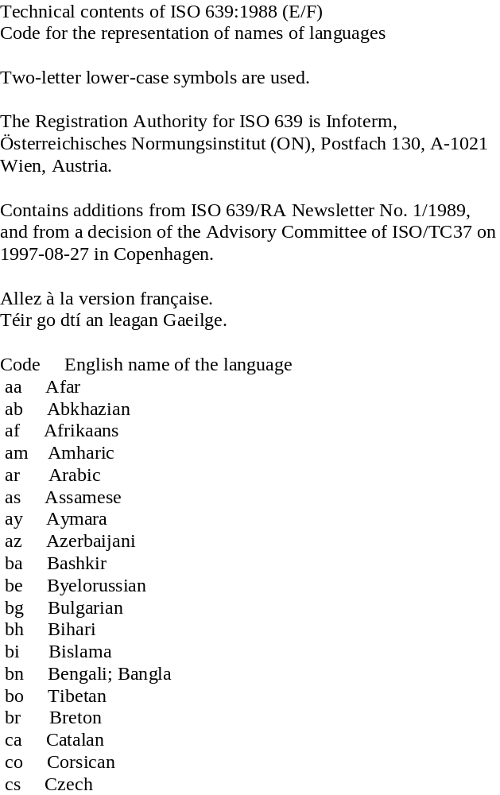
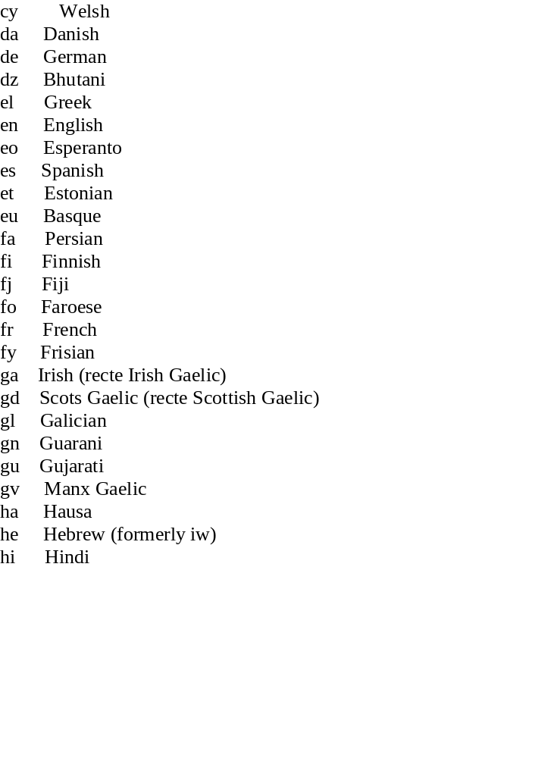

Slide 15
Creating Locales
The country code should be a valid ISO country code, that is, an UPPERCASE, two-letter codes as defined by ISO-3166.
  CA stands for Canada
  CN for China
  DK for Denmark
  DE for Germany

Slide 16
Creating Locales
The third argument (variant) is rarely used and are needed only for exceptional or system dependent situations to designate information specific to a browser or vendor.
For example, the Norwegian language has two sets of spelling rules, the traditional one called Bokmål, and a new one called Nynorsk.
The locale for traditional spelling is created as follows:
  Locale(“no”, “NO”, “B”);

Slide 17
Using Locales
Locale objects are really only of use if they are used in a particular context, e.g., currency display, or displaying a date/time
Java provides the following “Locale sensitive” classes, i.e., the way they are displayed depends on the region:
  Date (for dates)
  Calendar (for months, day names)
  Collator
  DateFormat (for format of dates, e.g., US versus UK)
  NumberFormat (for number formats, e.g. 3,000 versus 3.000 [UK versus EU]

Slide 18
public class InternationalNumbers {
public static void main(String[] args) {
int interestRate=10,years=10;
int loan=5,monthlyPay=2000,totalPay=60000;
Locale locale = new Locale("de","DE"); //For Germany
// Get formatters
NumberFormat percForm = NumberFormat.getPercentInstance(locale);
NumberFormat currencyForm = NumberFormat.getCurrencyInstance(locale);
NumberFormat numberForm = NumberFormat.getNumberInstance(locale);
percForm.setMinimumFractionDigits(2);
// Display formatted input
System.out.println(percForm.format(interestRate*12));
System.out.println(numberForm.format(years));
System.out.println(currencyForm.format(loan));
// Display results in currency format
System.out.println(currencyForm.format(monthlyPay));
System.out.println(currencyForm.format(totalPay));
//Some internationalized date stuff!!!
DateFormatSymbols dfs = new DateFormatSymbols(locale);
String dayNames[] = dfs.getWeekdays();
// Set calendar days
for (int i=0; i<7; i++)
System.out.println(dayNames[i+1]);
}
}
Change locale and EVERTHING changes
What appears on the screen depends on locale setting

Slide 19
Getting the Locales available
All locale-sensitive classes contain a static method getAvailableLocale( ) which returns an array of the locales they support, for example:
  Locale[ ] availableLocales = Calendar.getAvailableLocales( );
This returns all locales for which Calendars are installed.

Slide 20
Resource Bundles

Slide 21
What are resources?
In the general sense a resource is a supply which can be used in order to achieve an end, e.g. the natural resources of a country are used to supply energy for electricity etc.
In computer programming a resource could be any of the following: a file containing message strings, buttons labels, label text; and image or sound file; files with binary data etc.
Suppose you defined all of the strings in a java program in an external file...then it would be possible to change the display of your program merely by editing the resource file and without needing to recode
This type of separation is very useful when building internationalized java programs

Slide 22
java.util.ResourceBundle
Java has the means to define an object representing such a resource
The class java.util.ResourceBundle represents a resource which can be accessed by a java program
The resource can be any valid type, i.e. any object which extends from the ‘cosmic superclass’ java.lang.Object (which incidentally covers ALL objects)...use the getObject() method to retrieve arbitrary resource types
The ResourceBundle supplies a method called getBundle() which retrieves a resource e.g.
ResourceBundle res = res.getBundle(String bundleName,Locale loc)
As you can see the getBundle() method also accepts a Locale so that the appropriate localized resource can be found

Slide 23
Creating ResourceBundle
In general each resource is Locale specific e.g. a German resource file is written in German
In Java to create a ResourceBundle for a particular Locale create a class and extend the ResourceBundle base class e.g.
public class ProgramResource extends ResourceBundle {
private String[] keys = {"computeButton"};
public Enumeration getKeys() {
return Collections.enumeration(Arrays.asList(keys));
}
public Object handleGetObject(String key) { return keys; }
}

Slide 24
Creating ResourceBundle
In the previous slide a ResourceBundle was declared but no Locale specific identifiers were added to the class name..this class is the top of the resource hierarchy for our all our locales, it determines that the keys shall be returned as a list
This class also defines the key values that are used in your program to identify a particular localized resource e.g. a button which has “Compute” written on it for English speakers and “Rechnen” for German speakers, the key value for the button is “computeButton”
In order to write a locale specific class first decide on the name of your subclass (using the ISO language and country codes) and then extend the base class of your ResourceBundle hierarchy
For example the German language resource has the name
ProgramResource_de

Slide 25
Creating ResourceBundle’s
//German language resource bundle
public class ProgramResource_de extends ProgramResource {
public Object handleGetObject(String key) {
String returnString="";
if(key.equals("computeButton")) {
returnString = "Rechnen";
}
else if(key.equals("greeting")) {
returnString = "Wilkommen";
}
return returnString;
}
}
This method is responsible for matching the key value to the string literal used in the localised program!!!

Slide 26
Naming the resource classes
Follow the ISO standards for naming of resources
The general format is:
ProgramResource_language_country_variant
As with Locales you do not need to supply all three codes every time you define a new locale, any of the following forms are acceptable:
ProgramResource_language_country_variant
ProgramResource_language_country
ProgramResource_language
ProgramResource

Slide 27
Naming the resource classes
There’s one overwhelmingly good reason for naming your classes this way the following example explains why
Consider that the locale specific resource on the previous slide is the only resource class we have written, i.e. ProgramResource_de
The following lines of code create a locale for ‘de’ and ‘DE’ and then define a resource based on the same Locale object:
//Define a locale for german and Germany
Locale loc = new Locale(“de”, “DE”);
//Create a resource bundle for German language
ResoureBundle res = res.getBundle(“ProgramResource”,loc);

Slide 28
Loading the resource classes
The java environment will search for a ResourceBundle class based on the name supplied in the first parameter combined with the Locale codes e.g. ‘de’ and ‘DE’
Once this class has been found it will be loaded into the runtime environment for execution....but there is no ProgramResource_de_DE class available to the class loader, so this class will fail to load....!!!!!
But this program won’t stop yet!!!....the getBundle() method will continue to match classes which are higher up in the hierarchy but dropping the _DE from the class identifier....and therefore attempting to load a class called ProgramResource_de...this class does exist and therefore we get the closest match to our desired locale!!!!
This class matching will continue even if the _de did not match, and so the ProgramResource class would be loaded...this functionality is very useful

Slide 29
Loading the resource classes
In general the resource lookup will occur according the following steps:
  Search for the class with the exact locale extension
  If no such class exists drop the variant, if specified, and attempt to load
  If no such class exists drop the country code, if specified, and attempt to load
  If no such class exists drop the language code, if specified, and attempt to load
  If still not found, use the default locale
  If no default locale found throw a MissingResourceException

Slide 30
Another Resource
This class fits into the same resource hierarchy as before but deals with the English language and US country
public class ProgramResource_en_US extends ProgramResource {
public Object handleGetObject(String key) {
String returnString="";
if(key.equals("computeButton")) {
returnString = "Compute";
}
else if(key.equals("greeting")) {
returnString = "Welcome";
}
return returnString;
}
}

Slide 31
Using the ResourceBundle’s
Once each locale has it’s own class definition your java program can be written without any string literals used e.g. suppose you wanted to say “Welcome” in your program, normally you’d define a String with value “Welcome”
With ResourceBundle’s defined, instead of having String literals (or other objects which are locale-sensitive) in your program you define a key value, e.g. “greeting”
This key value is a locale-sensitive identifier and then the actual String can be retrieved via the ResourceBundle method e.g. res.getString(“message”); //Where res is a ResourceBundle reference
In the current example getString(“message”) will return the String “Wilkommen” for the _de Locale and “Welcome” for english Locales
getObject(String) is used when the resource is not only a String

Slide 32
//Sample GUI that uses resource bundles to internationalize
public class SimpleButtonGUI extends JFrame {
ResourceBundle res;
public SimpleButtonGUI() {
Locale loc = new Locale("de","DE"); //create Locale for German in Germany
res = res.getBundle("ProgramResource",loc); //Create resource bundle
JLabel greetLabel = new JLabel(res.getString("greeting")); //get value for greeting key value
JButton computeButton = new JButton(res.getString("computeButton")); //button key value
getContentPane().add(greetLabel);
getContentPane().add(computeButton,BorderLayout.SOUTH);
setSize(200,200);
setVisible(true);
}
public static void main(String[] args) {
SimpleButtonGUI myGui = new SimpleButtonGUI();
}
}

Slide 33
Adding extra locales
Adding extra locales to this sample program is straight forward...create new subclasses of the base class ProgramResource using the naming convention described earlier
Each of the new locale specific subclasses will implement the handleGetObject(String) method but the if statement will return the locale specific String’s e.g. “Bienvenue” for French key value “greeting”
However, there are considerable overhead’s in creating all of these if statements for every string in your program....
What can be done to reduce these overheads???....you can use the ListResourceBundle or PropertyResourceBundle classes!!!

Slide 34
java.util.ListResourceBundle
ListResourceBundle is particularly useful when the resources being localized are not strings
Instead of the ResourceBundle classes extending the ResourceBundle class the ListResourceBundle class is extended e.g.
public class ProgramResource_de extends ListResourceBundle {
private static final Object[][] contents = { {"computeButton","Rechnen"}, {"greeting","Wilkommen"} };
public Object[][] getContents() { return contents; }
}

Slide 35
java.util.ListResourceBundle
This subclass contains a two-dimensional array of Object’s which is a list of the key value pairs in the locale
The getContents() returns the Object array contents to the ListResourceBundle base class which carries out the processing needed to return the correct resource based on the key input (it calls the getObject() method in the background)
Using the ListResourceBundle will simplify the addition of new locale-sensitive resources to the program
Using the ListResourceBundle class requires no change to the GUI shown to demonstrate the ResourceBundle

Slide 36
java.util.PropertyResourceBundle
If the java program being created has a lot of String literals which are locale-sensitive, then using the PropertyResourceBundle will simplify the localization of these strings
The PropertyResourceBundle reads an external property file which contains ONE KEY VALUE PAIR PER LINE
A property file is simply a text file used to define properties e.g.
computeButton=Rechnen
greeting=Wilkommen
This property file could have the name “PropertyFile_de.txt”, for example, indicating that it localizes to German

Slide 37
java.util.PropertyResourceBundle
In order to read information from the property file, an InputStream object must be instantiated
This InputStream object is then passed to the PropertyResourceBundle which will use this to retrieve the correct literal for the key value passed
Fortunately java makes this easy by supplying a method getResourceAsStream method in the PropertyResourceBundle class which you can access using class reflection in your resource subclass e.g.
ProgramProperties_de.class.getResourceAsStream("ProgramProperties_de.txt")
Passing this to the superclass constructor will set up the ResourceBundle to read the property file

Slide 38
Using PropertyResourceBundle
//A PropertyResourceBundle for German
public class ProgramProperties_de extends PropertyResourceBundle {
public ProgramProperties_de() throws IOException {
super(ProgramProperties_de.class.getResourceAsStream("ProgramPro
perties_de.txt"));
}
}
One line of code imports the file!

Slide 39
public class SimplePropFileGUI extends JFrame {
ResourceBundle res;
public SimplePropFileGUI() {
Locale loc = new Locale("de","");
res = res.getBundle("ProgramProperties",loc);
JLabel greetLabel = new JLabel(res.getString("greeting"));
JButton computeButton = new JButton(res.getString("computeButton"));
getContentPane().add(greetLabel);
getContentPane().add(computeButton,BorderLayout.SOUTH);
setSize(200,200);
setVisible(true);
}
public static void main(String[] args) {
SimplePropFileGUI myGui = new SimplePropFileGUI();
}
}
Used different identifier for the Property class

Slide 40
ResourceBundle summary
Use the PropertyResourceBundle class for localization of strings...this means that the translator doesn’t even have to know how to edit Java code!!!
Use the ListResourceBundle class when non-String objects need to be localized
ResourceBundle’s are extremely useful, especially when combined with Locale objects

Slide 41
Playing Sound in Java
Applet Sound Engine makes playing sounds in Java simple…

Slide 42
Java Sound engine
You can use the Java Sound engine in standard JDK to play audio data from both applications and applets.
Java Sound enables you to play many types of audio clips, including AIFF, AU, WAV, MIDI, and RMF files.
This overview describes the features provided by the Java Sound engine and how it is integrated with standard JDK and the other Java Media technologies.
It shows you how you can play consistent, reliable, high-quality audio from your Java programs.

Slide 43
Java Sound engine
Since JDK 1.2 enables you can create and play AudioClips from both applets and applications.
The clips can be any of the following audio file formats:
  AIFF
  AU
  WAV
  MIDI (type 0 and type 1 files)
  RMF
The sound engine can handle 8- and 16-bit audio data at virtually any sample rate.
If the hardware doesn't support 16-bit data or stereo playback, 8-bit or mono audio is output.

Slide 44
Playing Sounds
With the standard JDK you can play many different types of audio files from both applets and applications, unlike JMF that needs to be specifically added/installed
  Audio is stored in files. There are several formats of audio files.
  The JDK can play several audio file formats, including .wav and .au files.

Slide 45
Playing Sounds
play(URL url, String filename);
Plays the audio clip after it is given the URL and the file name that is relative to the URL. Nothing happens if the audio file cannot be found.
play(getCodeBase(), "soundfile.au");
Plays the sound file soundfile.au, located in the applet’s directory.
play(getDocumentBase(), "soundfile.au");
Plays the sound file soundfile.au, located in the HTML file’s directory.

Slide 46
Using AudioClip interface
public AudioClip getAudioClip(URL url);
public AudioClip getAudioClip(URL url, String name);
Either method creates an audio clip. Specify String name to use a relative URL address.
public abstract void play()
public abstract void loop()
public abstract void stop()
Use these methods to start the clip, play it repeatedly, and stop the clip, respectively.

Slide 47
Playing sound in Applets
To play a sound file, load the clip by using Applet.getAudioClip and control playback through the AudioClip play, loop, and stop methods.
  For example, to play a WAV file from an applet, you could
1. Call Applet.getAudioClip and pass in the URL where the .wav file is located.
2. Call play or loop on the AudioClip.
  The audio data is loaded when the AudioClip is constructed.

Slide 48
Code to play a sound
Regardless of the type of sound file used, the code for loading and playing the file is the same.
This example provides a framework for loading and playing multiple audio clips and loads the audio clips asynchronously.
The code for loading and playing the clips is:
AudioClip audioClip = Applet.getAudioClip(baseURL, relativeURL);
onceClip.play(); //Play it once.
loopClip.loop(); //Start the sound loop.
loopClip.stop(); //Stop the sound loop.

Slide 49
Play a sound in an Application
Applications as well as applets can play sounds.
The newAudioClip method is contained in the java.applet.Applet class to enable applications to create AudioClips from a URL.
public static final AudioClip newAudioClip(URL r)

Slide 50
Play a sound in an Application
To play a sound from an applet, you call Applet.newAudioClip to load the sound and then use the AudioClip play, loop, and stop methods to control playback.
To play a WAV file from an application, you could therefore …
  1. Call Applet.newAudioClip and pass in the URL where the .wav file is located.
  2. Call play or loop on the AudioClip.

Slide 51
Play a sound in an Application
A sound player in the previous example can easily be implemented as an application.
The main difference is that Applet.newAudioClip is called to load the sounds.
AudioClip audioClip = Applet.newAudioClip(completeURL);

Slide 52
Testing the sound application
We have seen that Java programs can manipulate and play audio clips.
You can therefore capture your own clips and play them in your programs.
Obviously you need the proper equipment to achieve this
… sound card in the PC and speakers or headphones.

Slide 53
AudioClip for simple sound types
The sound engine that plays the audio-clips supports several audio file formats:
Sun Audio file format
⇒ .au extension
Windows Wave file format
⇒.wav extension
Macintosh AIFF file format
⇒ .aif or .aiff extension
Musical Instrument Digital Interface (MIDI) file format
⇒.mid or .rmi extensions
To play more complex sounds you may have to use the Java Media Framework supports many additional formats.

Slide 54
Labwork Exercise 1
Create a new project in Eclipse
Create a JFrame application that contains ONE JButton with the label “List All Locales” and ONE JTextArea. Output ALL available Locales to the JTextArea when the JButton is pushed.

Slide 55
Labwork Exercise 2
Create a new project in Eclipse
Modify the JFrame from the previous slide. Add a JComboBox with “English” and “French” listed . Use Resource bundles to translate the english JButton to French “Montrer tous les Locales” when the French option is selected. The JComboBox should also be internationalized to read “Francais” and “Anglais” when French is the selected language.

Slide 56
Labwork Exercise 3
Create a JFrame in Eclipse with one button to play a sound file (wav or au) of your choice using the AudioClip interface

